Slide 1

PROJECT REPORT
TOPIC:
DESIGN WEBSItE FOR KIDS
(kids-zone)
Instructor: Trần Văn Điệp
Group: Black Crow
Leader: Nguyen Quang Hung
Member: Đoan Manh Cuong
Nguyen Tung Lam
Ha Trung Kien

Slide 2
Website Overview
Home Page
Word Page
Color Page
Animal Page
Vegetable Page
Calendar Page
Contact Us
1
2
3
4
5
6
7

Slide 3
Purpose Of The Subject
Website development for children for the purpose :
Get acquainted with the alphabet, the number from 1 to 10.
Get to know the color.
Know more about vegetables and animals.
Knowledge of date, month.

Slide 4
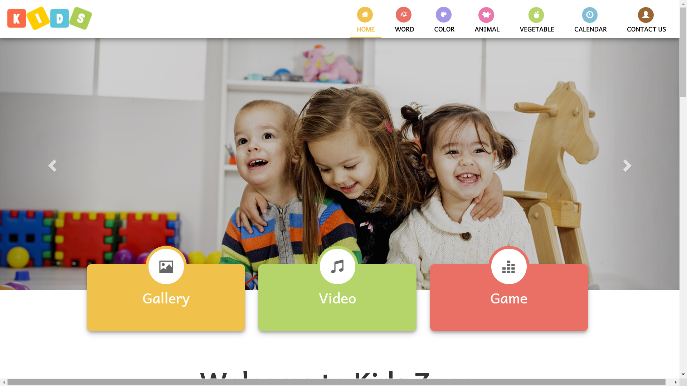
HOME Page
Where to create the interest of children, so that children begin to learn and become familiar with knowledge
Gallery: Highlight pictures, create excitement for children.
Video: These are short clips of teaching children through songs.
Game: Simple games, help children relax and consolidate knowledge.

Slide 5
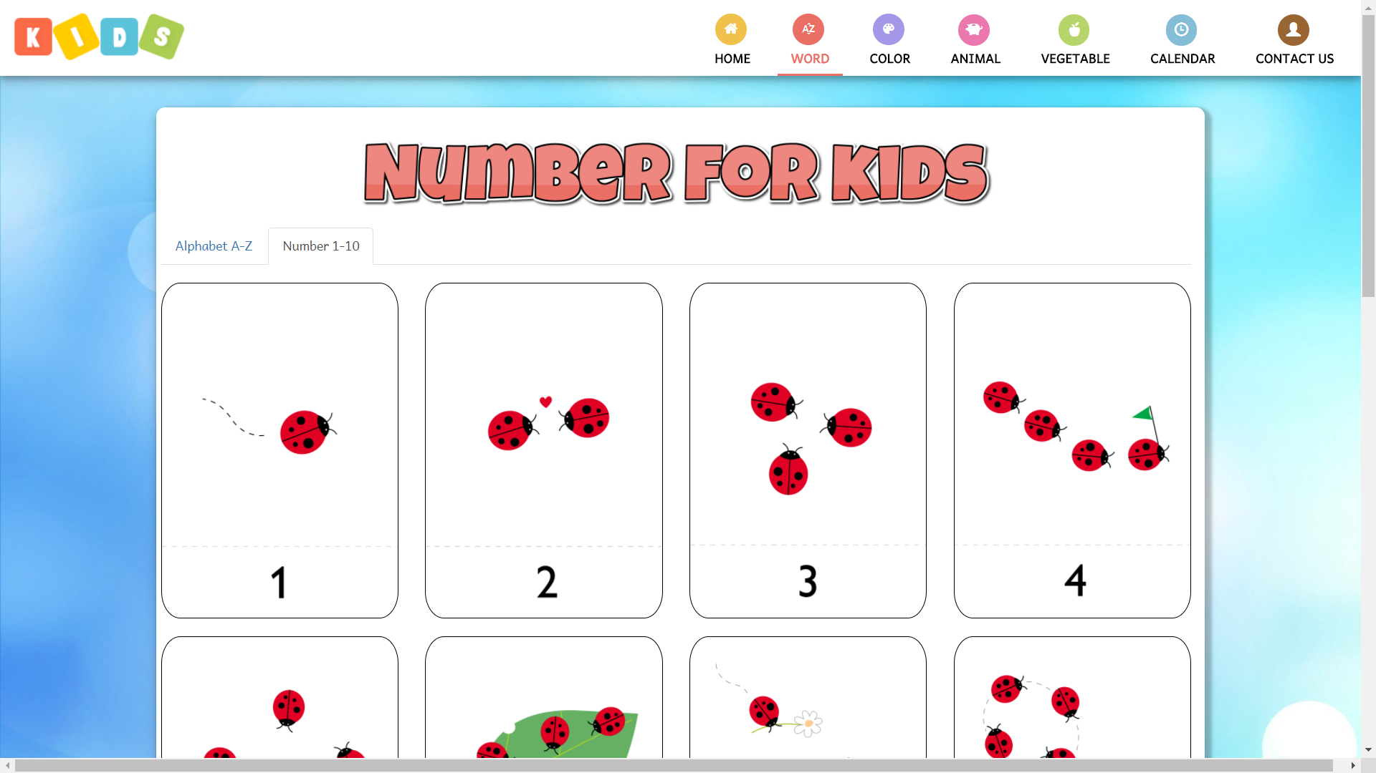
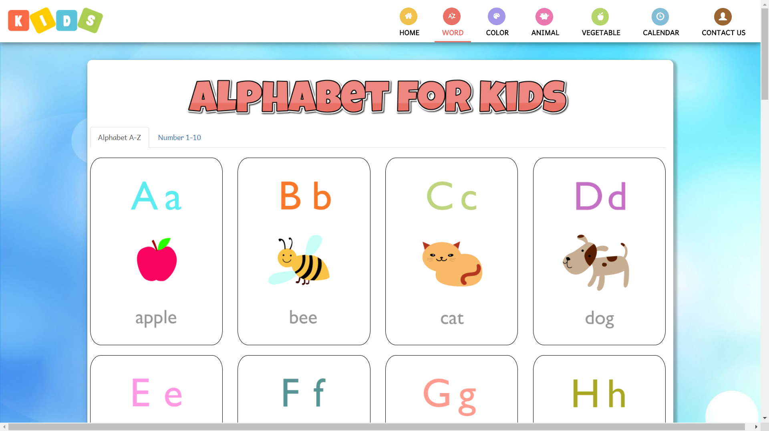
WORD Page
Assemble the alphabet and numbers from 1 to 10 with vivid images so that children are easy to remember
In the alphabet, flashcard include upper and lowercase letters with images representing the letters
In the number, the flashcard consists of numbers and pictures of the number of animals corresponding to each number
When clicked on the flash card, the sound of that card will play

Slide 6
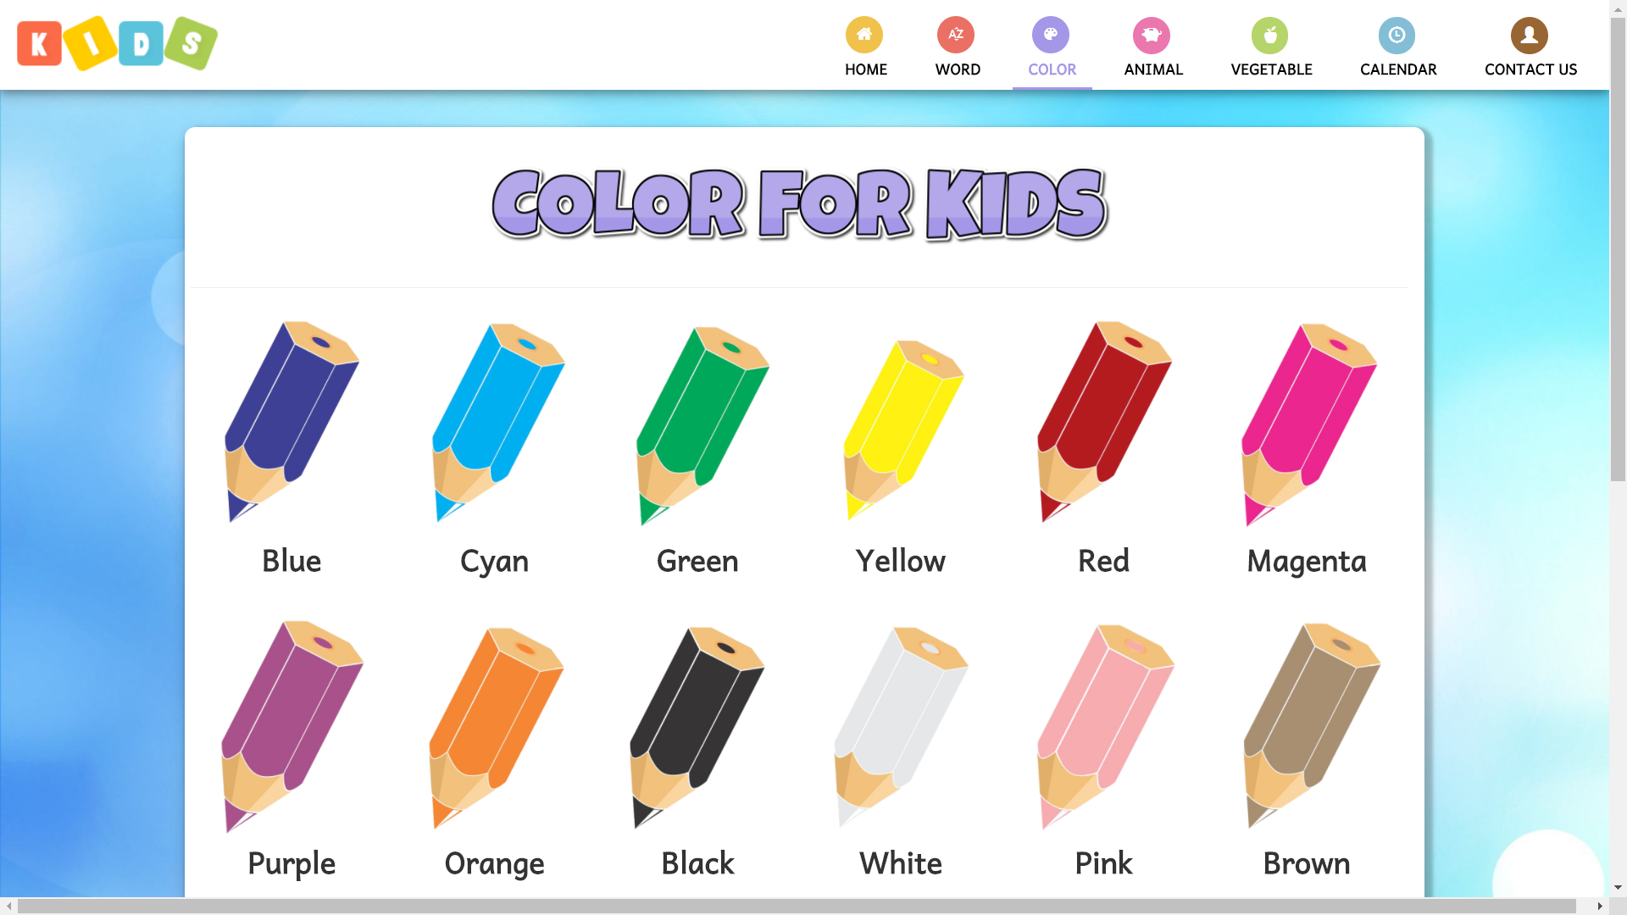
COLOR Page
This page shows the 12 basic colors
When moving the cursor to the image, the pen image will move and the name of the pen will turn into that color.
When clicked on the pen, the sound of that color will play

Slide 7
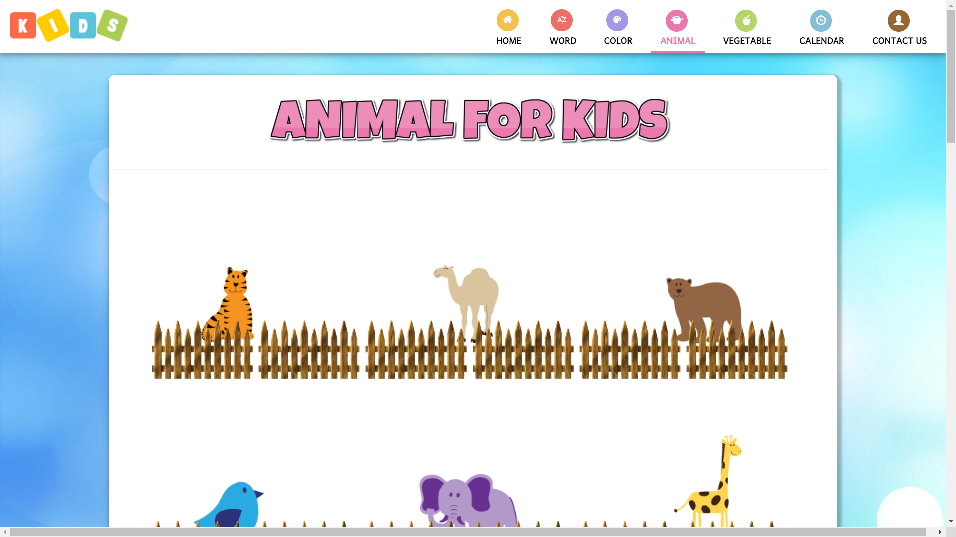
ANIMAL Page
Listed some popular wildlife.
This page contains an cartoon animal image, along with a name when move the cursor at them.
When clicked on animal, the sound of the animal's name will play.

Slide 8
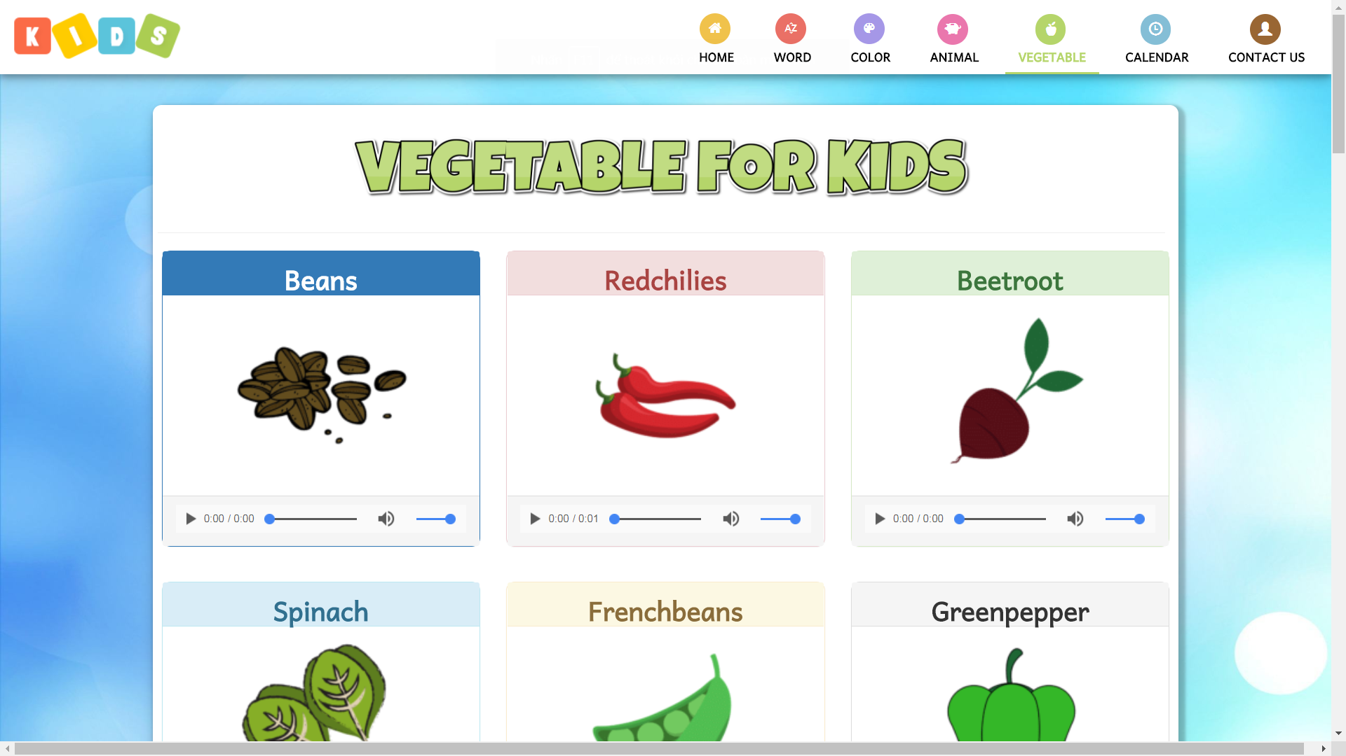
VEGETABLE Page
Listed some familiar vegetables
Have pictures, sounds
Helping children to identify vegetable
Increase awareness about vegetable
Acquire foreign languages ​​naturally
Help children be smarter
Make children interested in learning, exploring

Slide 9
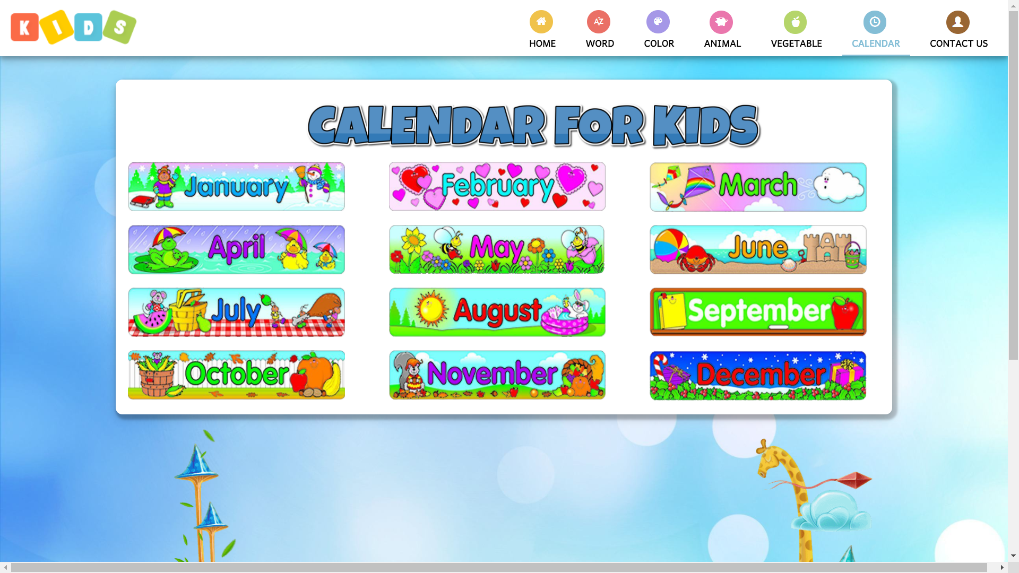
CALENDAR Page
List the months of the year
Clicking on the picture will play sound
Get to know the date
Easy to grasp the sound
Learn foreign languages ​​easily, vividly

Slide 10
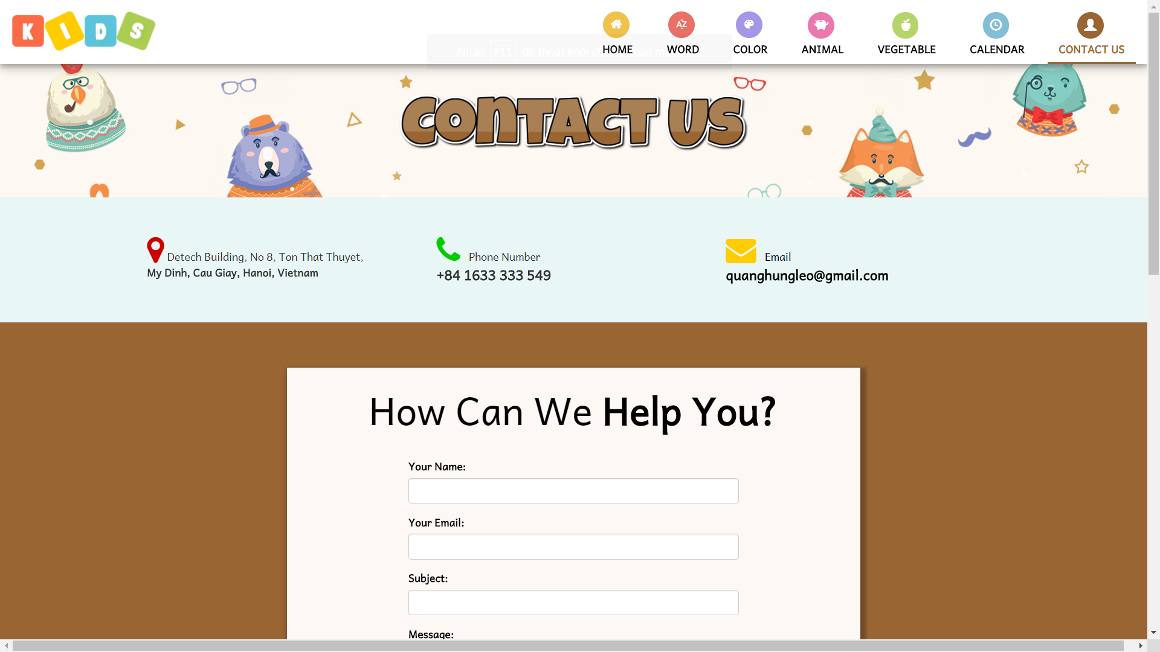
CONTACT US
This page help parents feedback about the content of the site as well as providing feedback to developers
Contact phone number
Company Address (Google Map)
Contact Email
Dialog box to send the message

